Slide 1
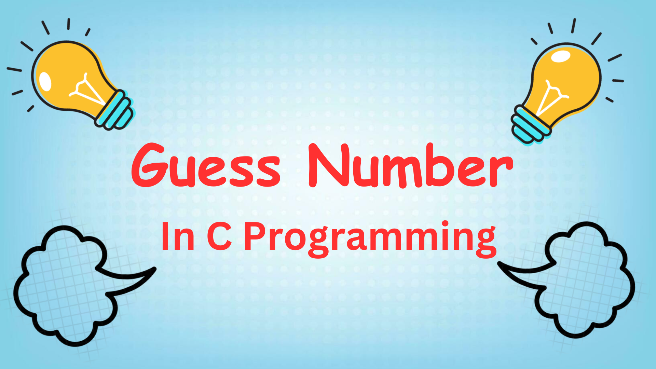
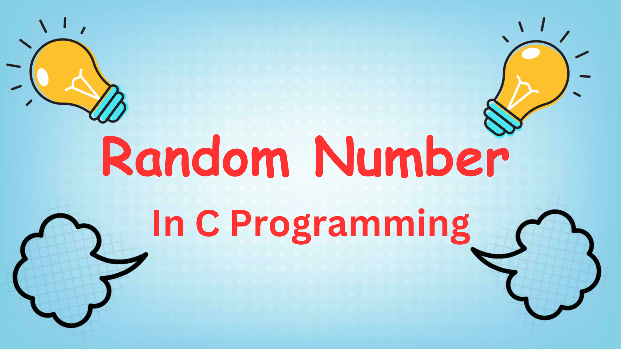

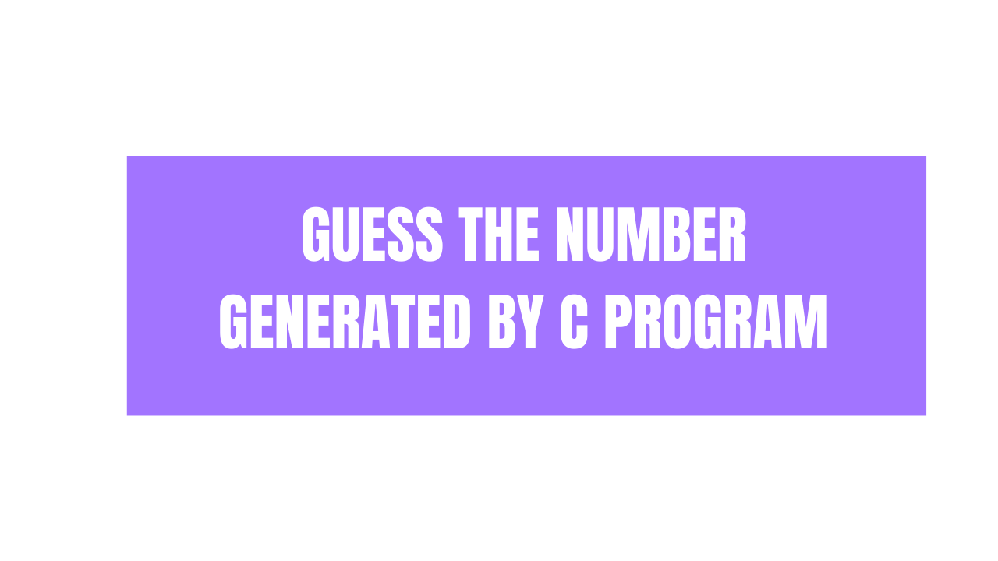

Slide 2
Create C program that will generate random number and user needs to guess the number
If user enters the number less then random number notify user to enter larger number.
If user enter the number greater then random number notify user to enter smaller number.
If user enter a correct number notify him/her that he/she wins the game and program will be terminated.
More Advancement
Ask user to enter number range in which program should generate random number.
Ask user to enter number of try he/she can do to guess the number.

Slide 3
Let’s Jump Into Code

Slide 4
Thank you for watching
@ProgrammingMinds

